Slide 1
2010 Water Quality Monitoring Activities
-Medicine Lake
-Twin Lake
Keith Pilgrim
Barr Engineering
March 17, 2011
brain huser is great

Slide 2
2010 Lake Water Quality Study for Medicine Lake

Slide 3
Long Term Monitoring Program
Detect Long Term Trends in Lake Water Quality…
  Land use changes
  BMP implementation
  In-lake activities
  Other, e.g. climate

Slide 4
What is Monitored
Phosphorus
Chlorophyll a
Clarity (by Secchi disk)
Basic lake characteristics
Zooplankton
Phytoplankton
Aquatic plants

Slide 5
Medicine Lake

Slide 6
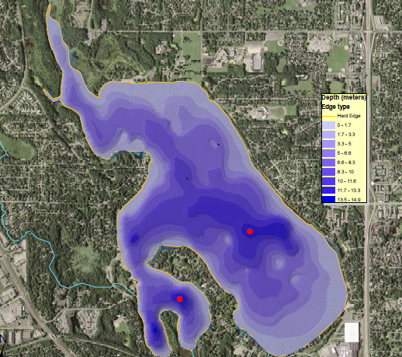
Medicine Lake (map)
Class: Level 1
Size: 886 ac
Max Depth: 49 ft
Average Depth: 16 ft
Littoral Area: 33% of total
Watershed:11,600 ac
Land use: commercial and residential
Water Quality Monitoring Locations

Slide 7
Medicine Lake
Historic Data: Summer Averages

Slide 8
Medicine Lake
Historic Data: Summer Averages

Slide 9
Medicine Lake
Historic Data: Summer Averages

Slide 10
Medicine Lake
2010 Data Compared to State Standards

Slide 11
Medicine Lake
2010 Data Compared to BCWMC Standards

Slide 12
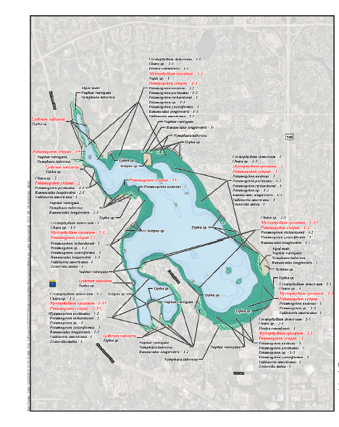
Aquatic Plants
Species: 20+
Tolerance: Moderate
Coverage: Growth to 10 ft
Density: Low to medium
Invasives: Eurasian watermillfoil, curlyleaf pondweed

Slide 13
Potential Lake Changes with TMDL Implementation
Increased lake clarity
Reduced blue-green algae populations
Increased aquatic plant coverage
Increased dissolved oxygen throughout the lake water column
If improved lake clarity, aquatic plant coverage, and dissolved oxygen, then improved habitat for aquatic life

Slide 14
Recommendations
Continued implementation of TMDL, BCWMC, and Plymouth Creek projects
Continued lake monitoring
Document and track activities and projects in the watershed that reduce phosphorus loading to Medicine Lake

Slide 15
Twin Lake Internal Phosphorus Loading Special Investigation

Slide 16
Purpose of Study
Identify reasons for recent increases in nutrients and algae in Twin Lake

Slide 17
Pertinent Twin Lake Characteristics
Surface area: 21 acres (small)
Maximum depth: 54 feet (quite deep)
Average depth: 25.7
Sheltered (protected from wind)
Small, largely undeveloped watershed
Connected to Sweeney Lake
Strongly stratified
Largely self contained, changes in water quality and biota due to internal (non-watershed) processes.

Slide 18
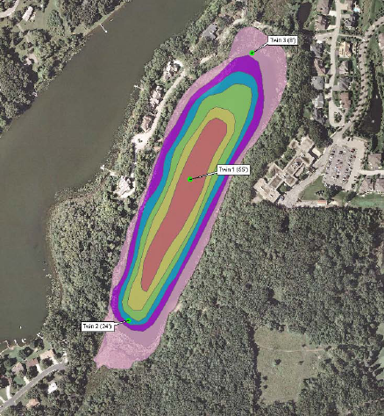

Slide 19
Pertinent Chemical and Biological Characteristics
Very low dissolved oxygen
  Nearly permanently low at depths below 16 feet
Very high rate of phosphorus loading from lake sediments (internal loading) during the summer and winter
Phytoplankton population now dominated by blue-green algae (cyanobacteria)

Slide 20
What Is Affecting the Water Quality of Twin Lake?
Lake sediments are permanently oxygen depleted
Nearly all phosphorus deposited on sediment is re-released (nutrient cycling)
Spring mixing=phosphorus transport to lake surface
Fall mixing=phosphorus transport to lake surface
Phytoplankton levels may be influenced by:
  Zooplankton abundance
  Blue green algae upward mobility

Slide 21
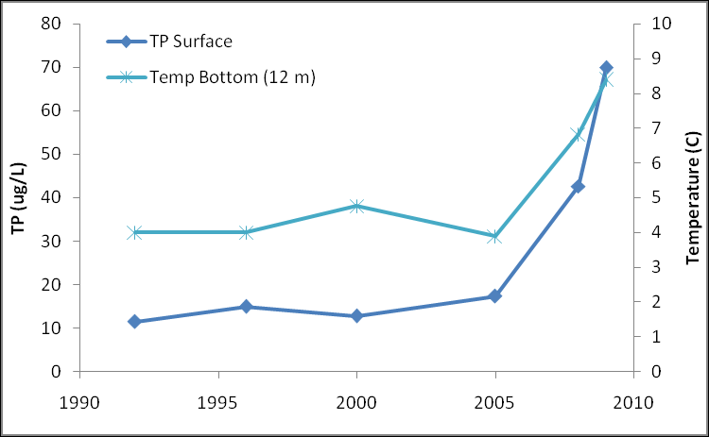
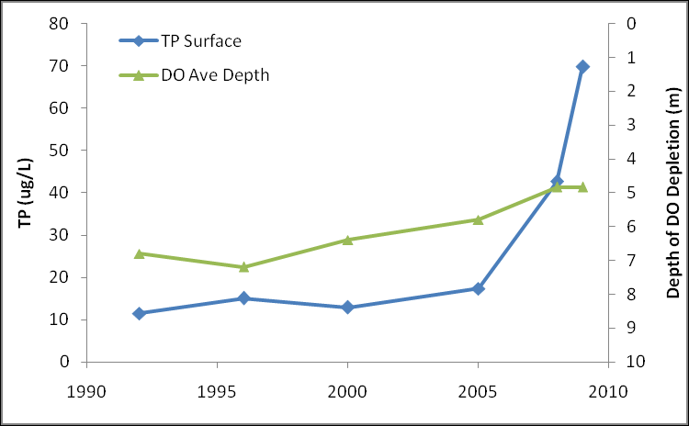
Why Has Phosphorus Increased in Recent Years…
The lake is warmer, oxygen is lower for more of the lake

Slide 22
Management Options for Internal Load Control
Hypolimnetic withdrawl
Sediment
phosphorus inactivation
Requires water inputs to replace water removed from lake bottom, several other drawbacks
Relatively inexpensive, can be effective on a long term basis for lakes with small watersheds

Slide 23
Management Options for Internal Load Control
Biomanipulation
Barley straw
Aeration
Innovative and natural way to control algae, appears to be occurring in Twin Lake already to some degree.
Most often used for small lakes and ponds, can prevent algal growth in some cases, requires annual treatment.
Can increase oxygen in lake water, however, may not stop internal loading and may transport phosphorus to the lake surface for algal growth

Slide 24
Management Options for Internal Load Control
Dredging
Can reduce internal loading, primary drawback is high cost

